Slide 1
Delirium
Dr/ Sanaa Saber Mohamed
Assistant Professor of Critical Care Nursing
2024

Slide 2
Outlines:
1- Introduction.
2- Definition of delirium
3- Causes of delirium.
4- Factors that precipitate the delirium occurrence.
5- Effects of delirium.
6- Types and Clinical Manifestations of delirium
7- Diagnostic Studies for delirium
8- Prevention of delirium
9- Management of delirium

Slide 3
Introduction.
Delirium is a common phenomenon in the ICU and may be related to sleep disturbance, the person’s underlying medical condition, the unfamiliar environment, medication side effects, or a combination of these factors. Elderly patients are especially vulnerable. it is a life-threatening, and possibly preventable syndrome. Delirium is the most frequent complication of hospitalization in older patients. In the hospital setting, 15% to 53% of older adults experience delirium postoperatively, and as many as 80% of patients in an intensive care unit (ICU) experience delirium. Comatose patients often, but not always, progress through a period of delirium before recovering to their baseline mental status.

Slide 4
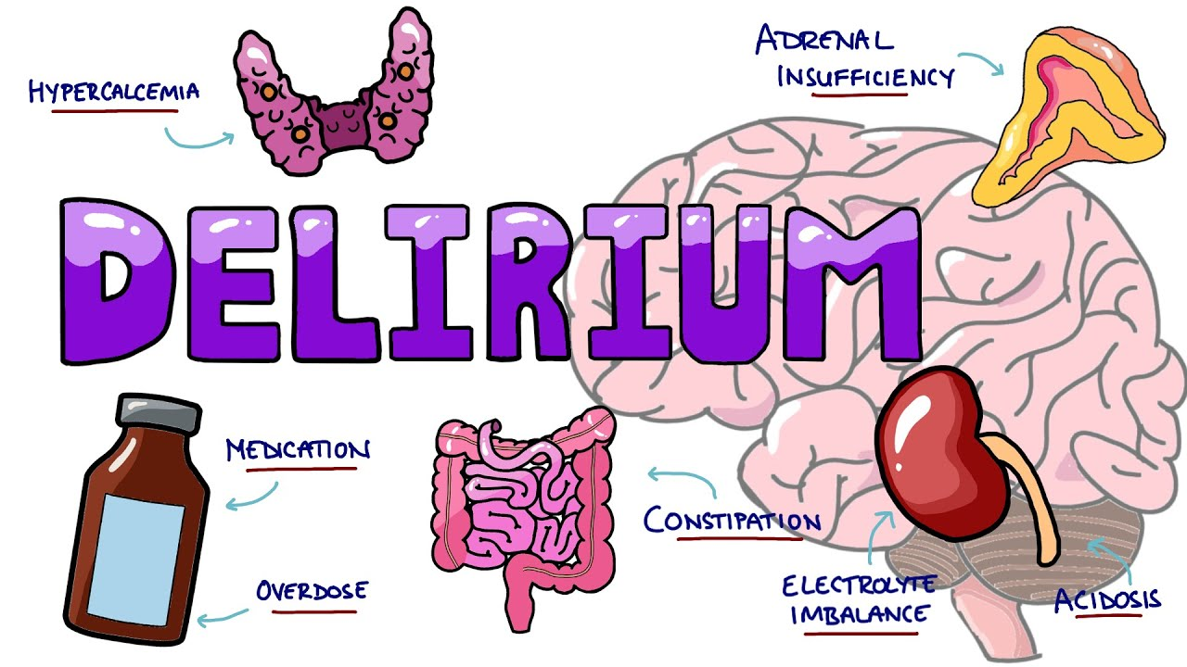

Slide 5
Definition of delirium
Delirium is a reversible cognitive disturbance associated with confusion, inappropriate behavior, decreased attention span, short-term memory impairment, and altered perceptions. Many delirious ICU patients have recently been comatose, indicating a fluctuation of mental status.
Delirium is a severe mental disorder, with or without organic damage, characterized by derangement of personality and loss of contact with reality and causing deterioration of normal social functioning.

Slide 6
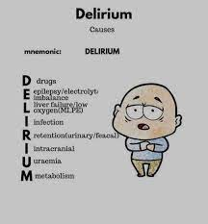
Causes of delirium:-
1- DELIRIUMS –causes
D : Drugs
E: eyes ,ears ( poor vision or hearing )
L: Low oxygen state ( CHF, COPD,ARDS)
I:Infection
R:Retention (urine ,stool)
I:Ictal state (seizure )
U:Underdehydration / under nutrition
M:Metabolix upset
S:sleep deprivation

Slide 7
2- DELIRIOUS
D: Drugs (continuous drips, Na+, Ca+, BUN/Cr, NH3+)
E:Environmental factors (hearing aids, eye glasses, sleep/wake cycle)
L :Labs (including Na+, K+, Ca+, BUN/Cr, NH3+)
I : Infection
R:Respiratory status (ABGs-PaO2 and PCO2) I Immobility
Organ failure (renal failure, liver failure, heart failure)
U :Unrecognized dementia
S :Shock (sepsis, cardiogenic)/Steroid

Slide 8
3- IWATCH DEATH
I: Infection
W : withdrawal( sedatives ,alcohol , barbiturates)
A :Labs (including Na+, K+, Ca+, BUN/Cr, NH3+)
T: Infection
C : CNS pathology: tumors, strokes, seizures
H :Hypoxia
D : Deficiency states: Thiamine, nicotinic or folic acid, B12
E: Endocrine dysfunctions (hypo/hyperthyroid, adrenal )
A:Acute vascular(Cardiovascular disease as CHF, arrhythmias)
T: Toxins /Drugs
H : Heavy meals

Slide 9
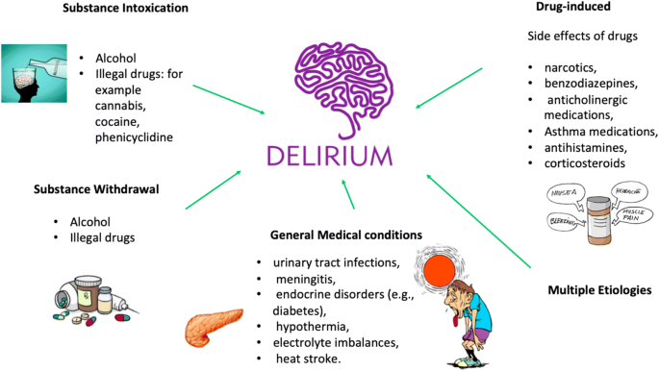

Slide 10
Factors that precipitate the delirium occurrence:
1- Demographic Characteristics
Age 65 years or older
Male gender
2- Cognitive Status
Dementia
Cognitive impairment
History of delirium
Depression
3- Environmental
Admission to an intensive care unit
Use of physical restraints
Pain (especially untreated)
Emotional stress
Sleep deprivation

Slide 11
4- Functional Status
Functional dependence
Immobility
History of falls
5- Sensory
Sensory deprivation
Sensory overload
Visual or hearing impairment
6- Drugs
Sedative-hypnotics
Opioids
Anticholinergic drugs
Aminoglycosides
Treatment with multiple drugs
Alcohol or drug abuse or withdrawal

Slide 12
7- Coexisting Medical Conditions
Severe acute or Terminal illness
Electrolyte imbalances
Chronic renal or hepatic disease
Neurologic disease (History of stroke)
Acute infection, sepsis, fever
8- Surgery
Orthopedic surgery
Cardiac surgery
Prolonged cardiopulmonary bypass

Slide 13
Effects of delirium
ICU delirium is a predictor of: ↑ mortality, ↑ length of stay, ↑ time on vent, ↑ costs, ↑ re-intubation, ↑ long-term cognitive impairment, and ↑ discharge to long-term care facility.

Slide 14
Types and Clinical Manifestations of delirium
1- Hyperactive or hyper alert
The patient is hyperactive, combative and uncooperative.
May appear to be responding to internal stimuli
Frequently these patients come to our attention because they are difficult to care for.
Signs:-
Increased psychomotor activity, such as rapid speech
Irritability

Slide 15
2- Hypoactive or hypo alert
- Patient appears to be napping on and off throughout the day
- Unable to sustain attention when awakened, quickly falling back asleep
- Misses meals, medications, appointments
- Does not ask for care or attention
- This type is easy to miss because caring for these patients is not problematic to staff
Signs
- Lethargy
- Slowed speech
- Decreased alertness
- Apathy

Slide 16
3- Mixed
- a combination of both types
- The most common types are hypoactive and mixed accounting for approximately 80% of delirium cases

Slide 17
Diagnostic Studies for delirium
The Confusion Assessment Method (CAM)
Laboratory tests include complete blood count, serum electrolytes, blood urea nitrogen, and creatinine levels; electrocardiogram; urinalysis; liver and thyroid function tests; and oxygen saturation level
x-rays
CT and MRI

Slide 18
Prevention of delirium
1- Provide adequate fluids
2- Provide stimulating activities and familiar objects
3- Encourage the use of eyeglasses and hearing aids, if applicable
4- Use simple and regular communication about people, place and time
5- Provide mobility and range-of-motion exercises
6- Reduce noise and avoid sleep interruptions
7- Provide appropriate pain management and offer nondrug treatment for sleep problems or anxiety

Slide 19
Management of delirium:
Four key steps in management of delirium are
• Addressing the underlying causes.
• Maintaining behavioral control.
• Preventing complications.
• Supporting functional needs.

Slide 20
The management strategies include both non pharmacologic and pharmacologic interventions.
1- Non-pharmacologic Interventions:
a- Physical Interventions:
- Initial interventions include general measures to support cerebral function, such as intravenous hydration and appropriate nourishment.
- Supplemental oxygen has been found to be highly effective in patients who develop delirium with pneumonia.
- Physical restraints, once a mainstay in the treatment of delirium, are now used only when all pharmacologic and non-pharmacologic interventions have failed.

Slide 21
b- Environmental Interventions:
- Over stimulation should be avoided, because it contributes to both confusion and insomnia
- place the delirious patient in a room close to the nursing station leaving a radio on in the patient's room
- To help the patient perceive the environment accurately, adequate daytime lighting and a night light should be provided
- Hearing aids, eyeglasses and other devices that assist sensory perception should be used whenever possible and should not be put away during a delirious episode
- Having family members stay with the patient. Family members should also be encouraged to bring personal effects from home, because some patients with delirium are greatly comforted by the presence of familiar photographs or objects.

Slide 22
c- Cognitive Interventions:
- Reorientation is one of the most easily accomplished cognitive interventions. The first step is to place a clock and a calendar where the patient can see them easily. The patient should then be verbally reoriented to time and place several times over the course of the day. Repetition is recommended to compensate for memory impairment in the delirious patient.

Slide 23
2- Psychological Interventions:
- The delusions expressed by a patient should not be directly disputed. Instead, alternative explanations of events should be offered, and frequent reassurance should be given.

Slide 24
3- Pharmacologic Interventions
- 100 mg of B1 IV for thiamine deficiency and IV fluids for fluid and electrolyte imbalances
- Symptomatic management: as many patients are agitated, emergency psychiatric treatments may be needed. Small doses of benzodiazepines (lorazepam or diazepam) or antipsychotics (haloperidol) may be given orally or parenterally.

Slide 25
4- Patient Education
- Educating families and patients regarding the etiology and course of disease is an important role for physicians.
- Educate the patient, family, and primary caregivers about future risk factors.
- Families may worry that the patient has brain damage or a permanent psychiatric illness. Providing reassurance that delirium often is temporary and is the result of a medical condition may be beneficial to both patients and their families.
- Suggest that family members or friends visit the patient, usually one at a time, and provide a calm and structured environment. Encourage them to furnish some familiar objects, such as photos or a favorite blanket, to help reorient the patient and make the patient feel more secure.

Slide 26
Prognosis:
Resolution of symptoms may take longer in patients with poor pre morbid cognitive function, incorrect or incomplete diagnosis of contributing factors, and structural brain diseases treated with large doses of psychoactive medications prior to the onset of acute medical illness. For some patients, the cognitive effects of delirium may resolve slowly or not at all.

